Slide 1
Research on Supporting Tool for Human Machine Pair Programming
Hiroshima University, Dependable Systems Lab
XIA YING 2024.5.28

Slide 2

Background
Human Machine Pair Programming
Human: creative but often make mistakes
creating algorithms, considering overall design, constructing software
Machine: faultless but not so creative
suggest contents to deal with potential defects and completing software
Supporting Tool
build an efficient and user-friendly prototype tool to support HMPP
incorporate two main processes:
Software Construction Monitoring: identify potential faults and report them timely and properly
Software Construction Predicting: suggest improvements to solve faults and facilitate software completion.
Transform from structured programming to object-oriented-programming(OOP)
Facilitate the software completion from pseudo-code requirement to pure code

Slide 3
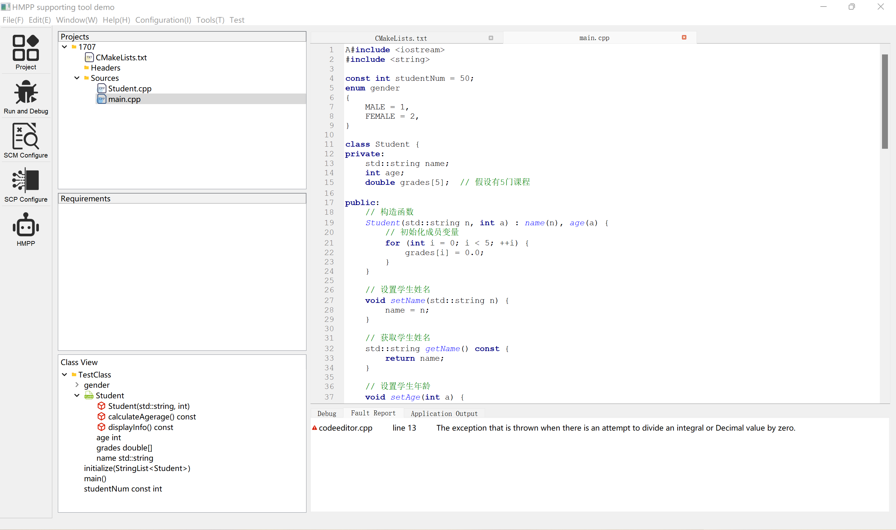
Current Progress: Creating the interface of the supporting tool
1 Menu
5 Code Editor
3 Project Hierarchy
4 Spec Requirement
2 Tool Box
5 Class View
6 Problem Tab

Slide 4
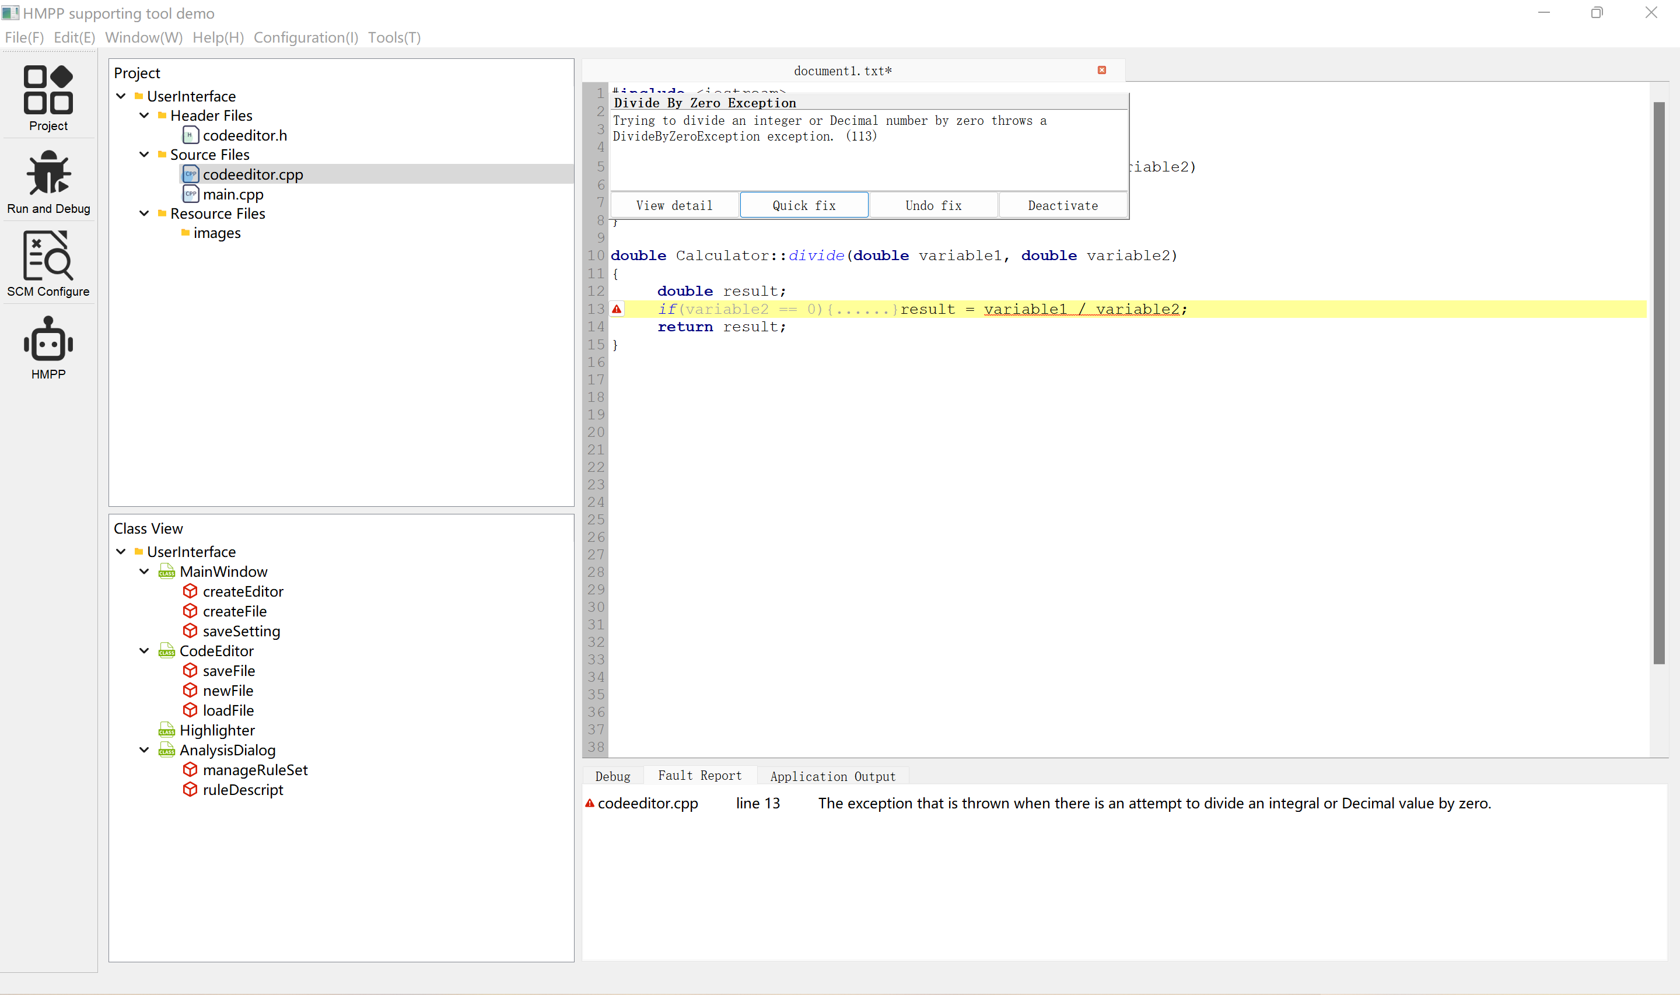
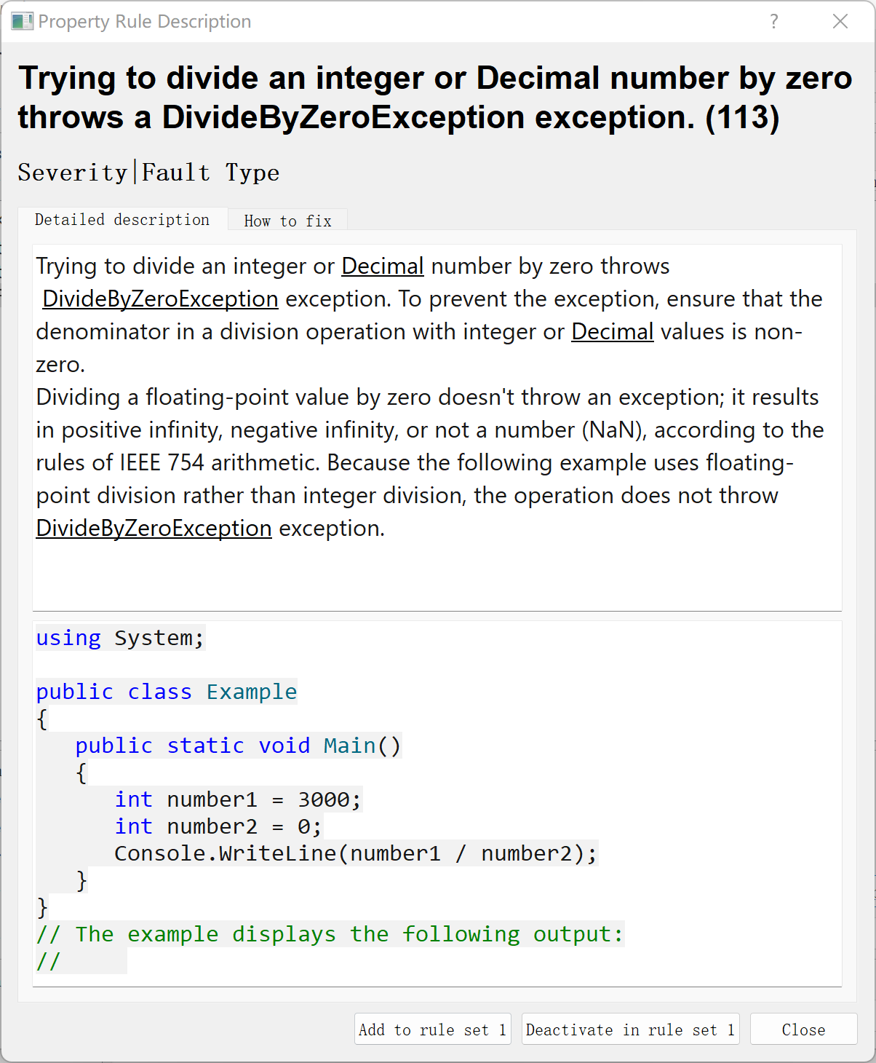
Current Progress: Software Construction Monitoring
Identify potential faults and report them timely and properly
Fault Description
Tip Box
Fault Line
Fault Report Tab

Slide 5
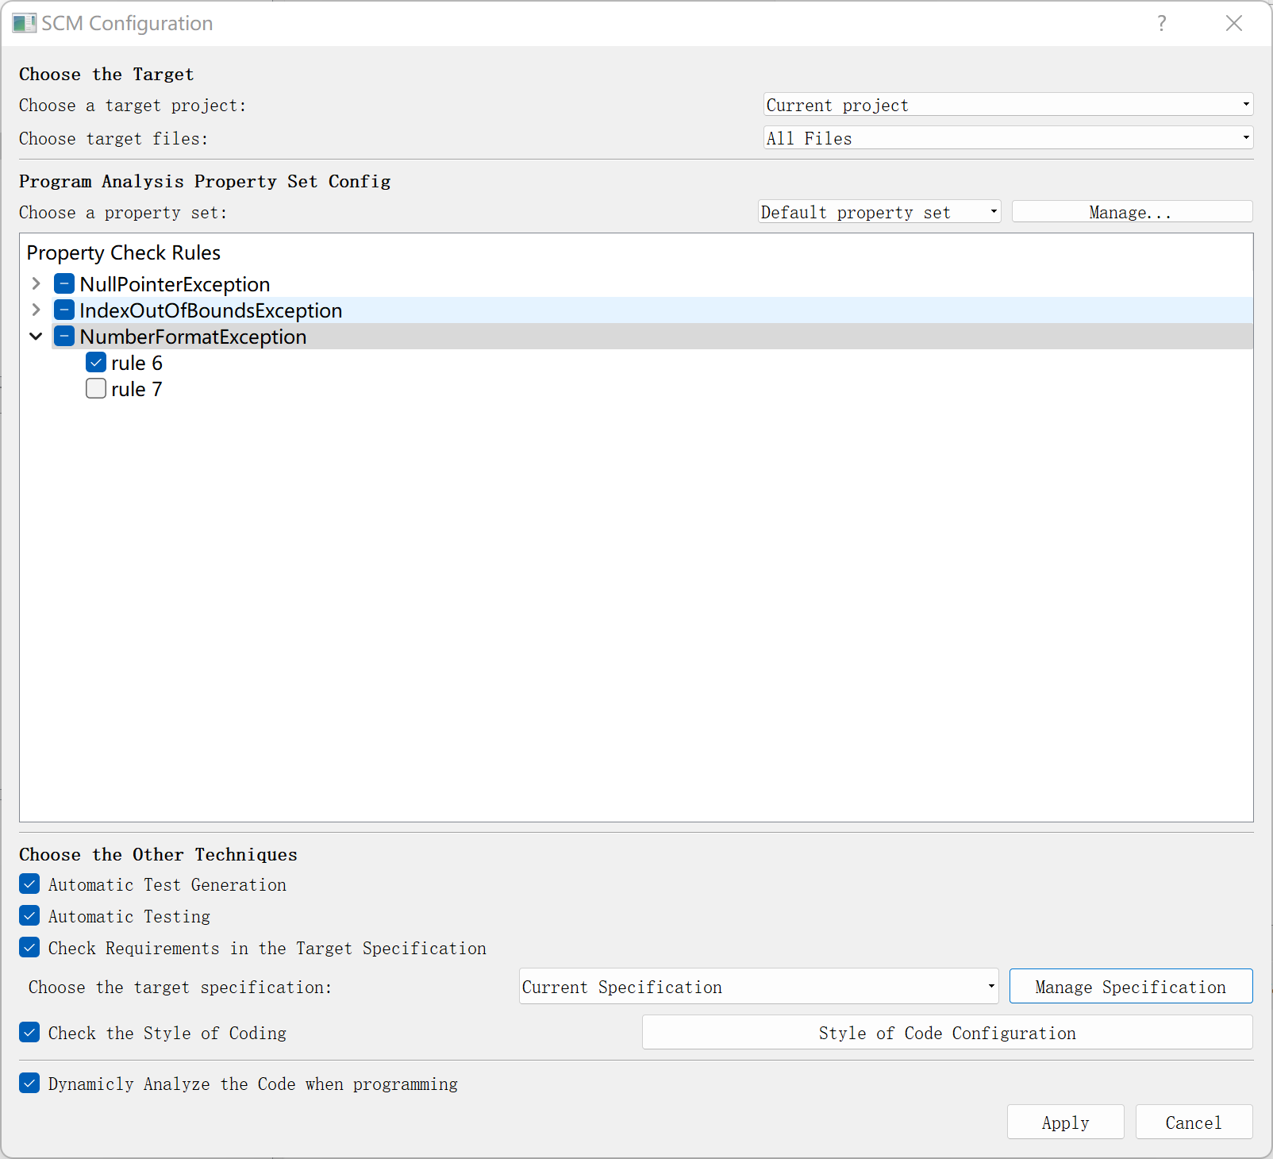
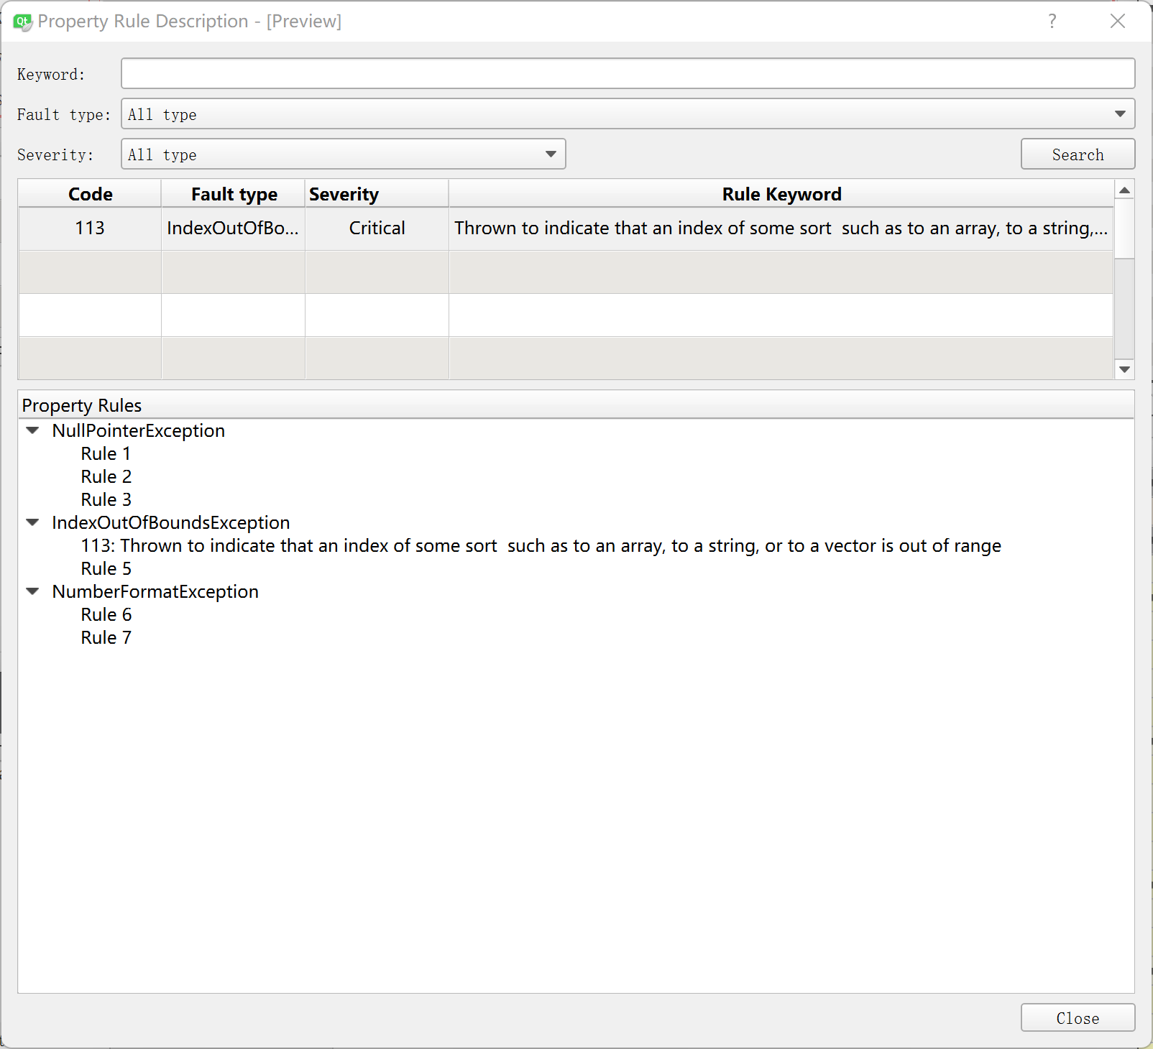
Current Progress: Software Construction Monitoring
Manage the rule set and configuration to identify faults

Slide 6

Current Progress: Transform to OOP
Idea of structured programming, Implementation of object-oriented programming
Suppose we are designing a stock reservation and purchase system.
The first idea comes to our mind is ——
what are the functions of this system?
Functions: Customer Registration, Stock Registration, Purchase Stock ...
However,
The first thing OOP requires us to do is ——
what are the objects included in the system?
Objects: Customer, Stock, System Manager, Bank, Transaction ...
So this is the contradiction that exists between how we think about things and how we actually write code.

Slide 7
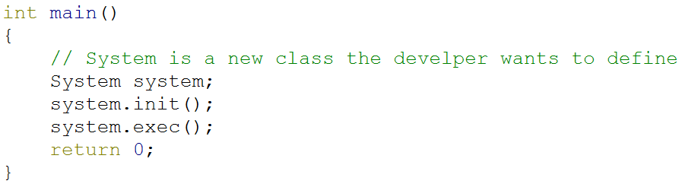
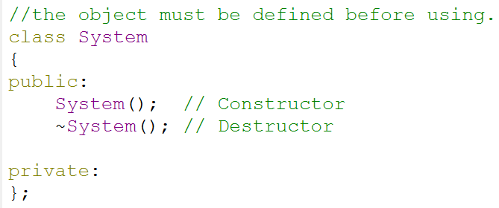
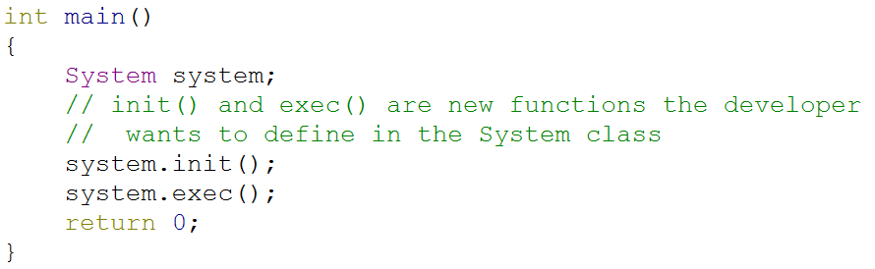
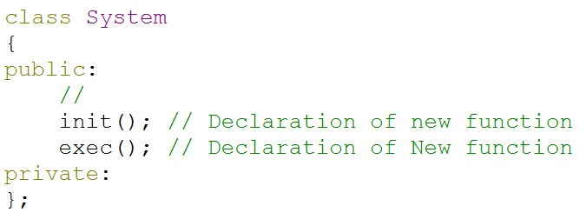
Current Progress: Transform to OOP
Moreover, when we actually do object-oriented programming, there are also many programming syntax constraints that interrupt our thinking process.
Example 1: when calling an object of a new class, we must first define its class name, members, constructors and destructors in the header file;
Example 2: when calling a new member of the existing class, it must first be declared in the header file.

Slide 8
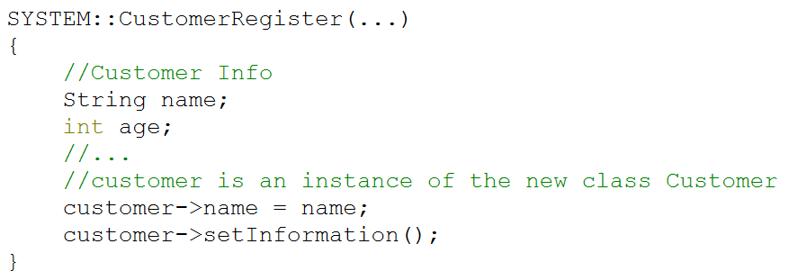
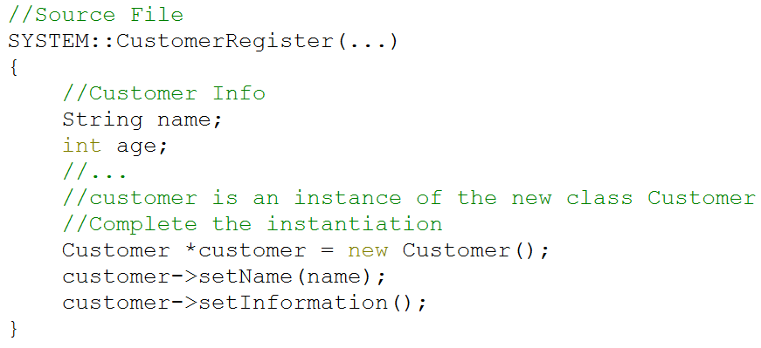
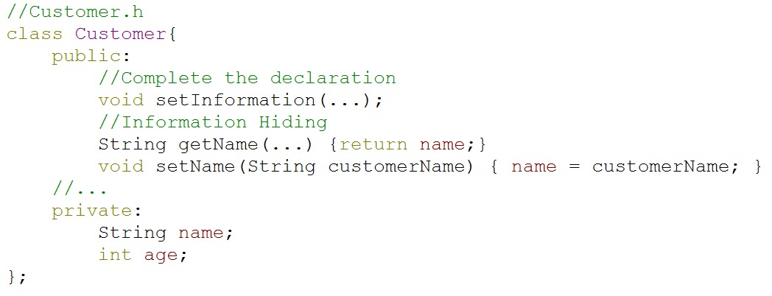
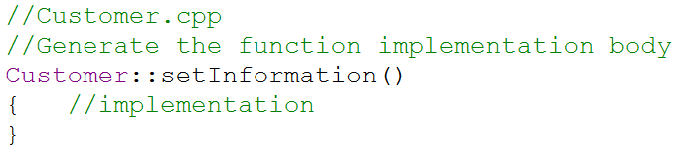
Current Progress: Transform to OOP
In order to help developers spend less time caring about the programming systax constraints and more time writing algorithms, the tool can automatically encapsulate source code into object files
The develop writes:
The tool generates:
1. Complete the instantiation
2. Complete the declaration and information hiding
3. Generate the implementation function body

Slide 9
Current Progress: Transform to OOP
Generate the class header file and source file based on the class constructor;
Generate the class declaration and constructor declaration in the header file;
Generate the constructor implementation function body in the source file.
Case Description | The developer writes: | The tool helps generate:
Define a new class by calling the constructor | //*.cpp Customer customer(name, age, ...); | //Customer.h class Customer { Customer(char* _name, int _age, ...) : name(name), age(age); private: char* name; int age; } //Customer.cpp Customer(char* _name, int _age, ...) : name(name), age(age){...}
 | //*.cpp Customer customer(); | //Customer.h class Customer { Customer(){}; }

Slide 10
Current Progress: Transform to OOP
Generate the class header file and source file;
Complete the definition of the instance before the call statement;
Generate the class declaration in the header file.
Case Description | The developer writes: | The tool helps generate:
Define a new class by directly accessing its member | //*.cpp customer.register(...); | //*.cpp Customer customer; customer.register(); //Customer.h class Customer{ };
 | //*.cpp customer->name; | //*.cpp Customer customer; customer->getName(); //Customer.h class Customer{ };

Slide 11
Current Progress: Transform to OOP
Case Description | The developer writes: | The tool helps generate:
Define a new class member Generate the class member declaration in header file; Generate the implementation function body of member function in the source file; Generate the getter and setter function for member variable in the header file. | //*.cpp customer.register(...); | //Customer.h class Customer { public: void register(...); } //Customer.cpp void Customer::register(...){...}
 | //*.cpp customer->name; | //*.cpp customer->getName(); //Customer.h class Customer { private: char* name; public: char* getName(){return name}; void setName(char* _name){ name = _name; } }

Slide 12
Current Progress: Transform to OOP
Programming syntax analysis
Regular Expression Match
class->method(parameters){...}
class->variable
class.method(parameters){...}
class.variable
Three types of expression:
returnType scope::method(parameters)
type scope::variable
constant: 3.14，0，“String”，True，...
After programming syntax analysis of the source file, the tool can acquire the class information and generate corresponding files and statements.

Slide 13
Current Progress: Transform to OOP
Benefits:
Allow developers to focus more on writing algorithms without wasting time on trivial details of programming syntax such as defining objects and defining function declarations.
In line with the ways humans think about things.
Enhances the maintainability, reusability and extensibility of the software as OOP is supposed to do.

Slide 14
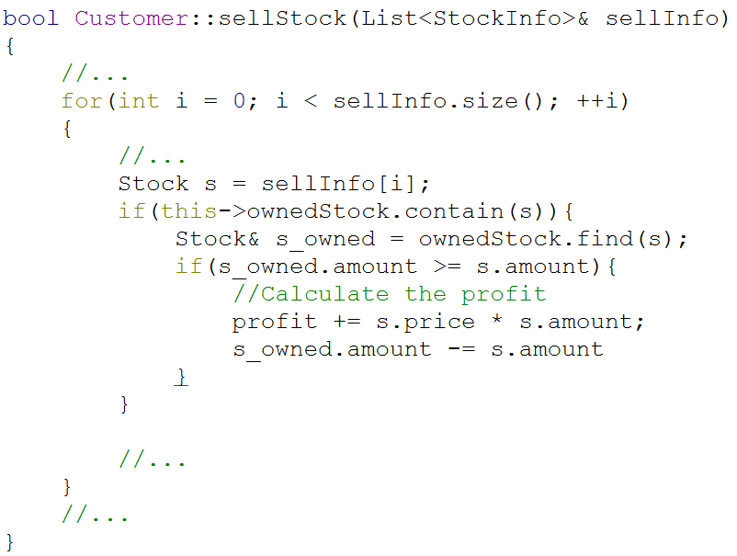
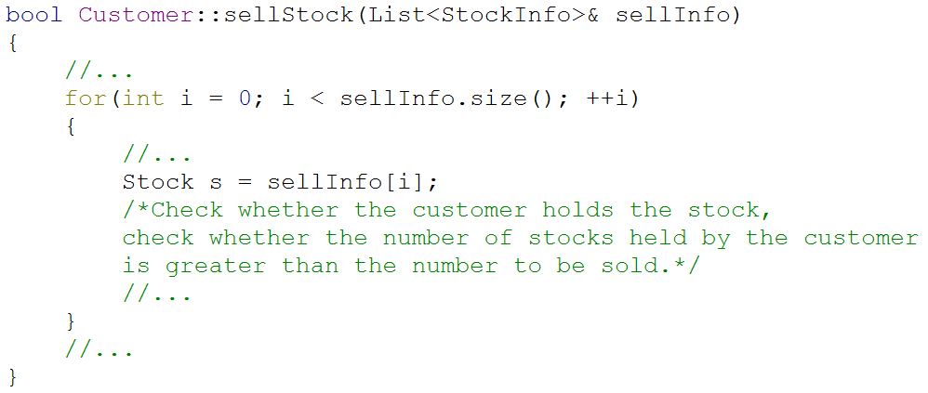
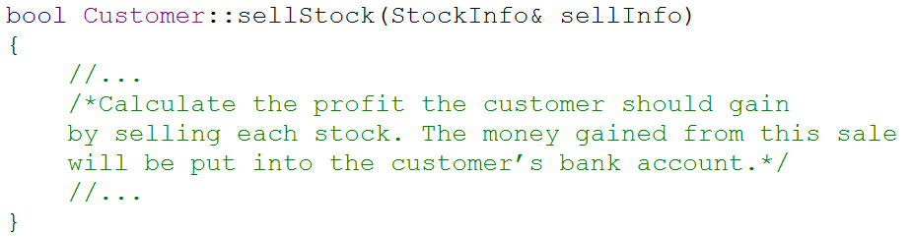
Current Progress: Facilitate the completion of pseudo-code
Problem1: When developers are writing code, they may encounter requirements that they don't know how to implement.
Developers can record the requirements in natural language or pseudocode
Remind developers to continue to implement pseudocode requirements when appropriate.
other pseudo-code requirement
Level 2
Level 1
Level 3
Problem2: The implementation of pseudo-code requirements is not likely to be achieved overnight.
Developers can still iterate the pseudo-code in the same way until the pure code is implemented.
Record all the historical codes and integrate them, thus completing the entire development process.
other pseudo-code requirement
Notes:
When developers are writing code, they may encounter requirements that they don't know how to implement.
At this time, developers can record the requirements in natural language or pseudocode, and implement the later requirements first to ensure the continuity of thinking.
This tool will remind developers to continue to implement pseudocode requirements when appropriate.
Moreover, the implementation of pseudocode requirements is not likely to be achieved overnight. Developers can still iterate the pseudo-code layer by layer in the same way until the pure code is finally implemented.
In this way, the tool will record all the historical codes and integrate them, thus completing the entire development process.

Slide 15
Future Research Plan
Improve the tool's capabilities of user interaction in transforming to OOP, such as giving prompts in a proper way, guiding the user to complete the definition of class members that the tool does not know about.
Develop the tool's capabilities of managing pseudo-code requirements, recording historical code, facilitating the implementation of pure code.
Thank you for listening.

